Slide 1
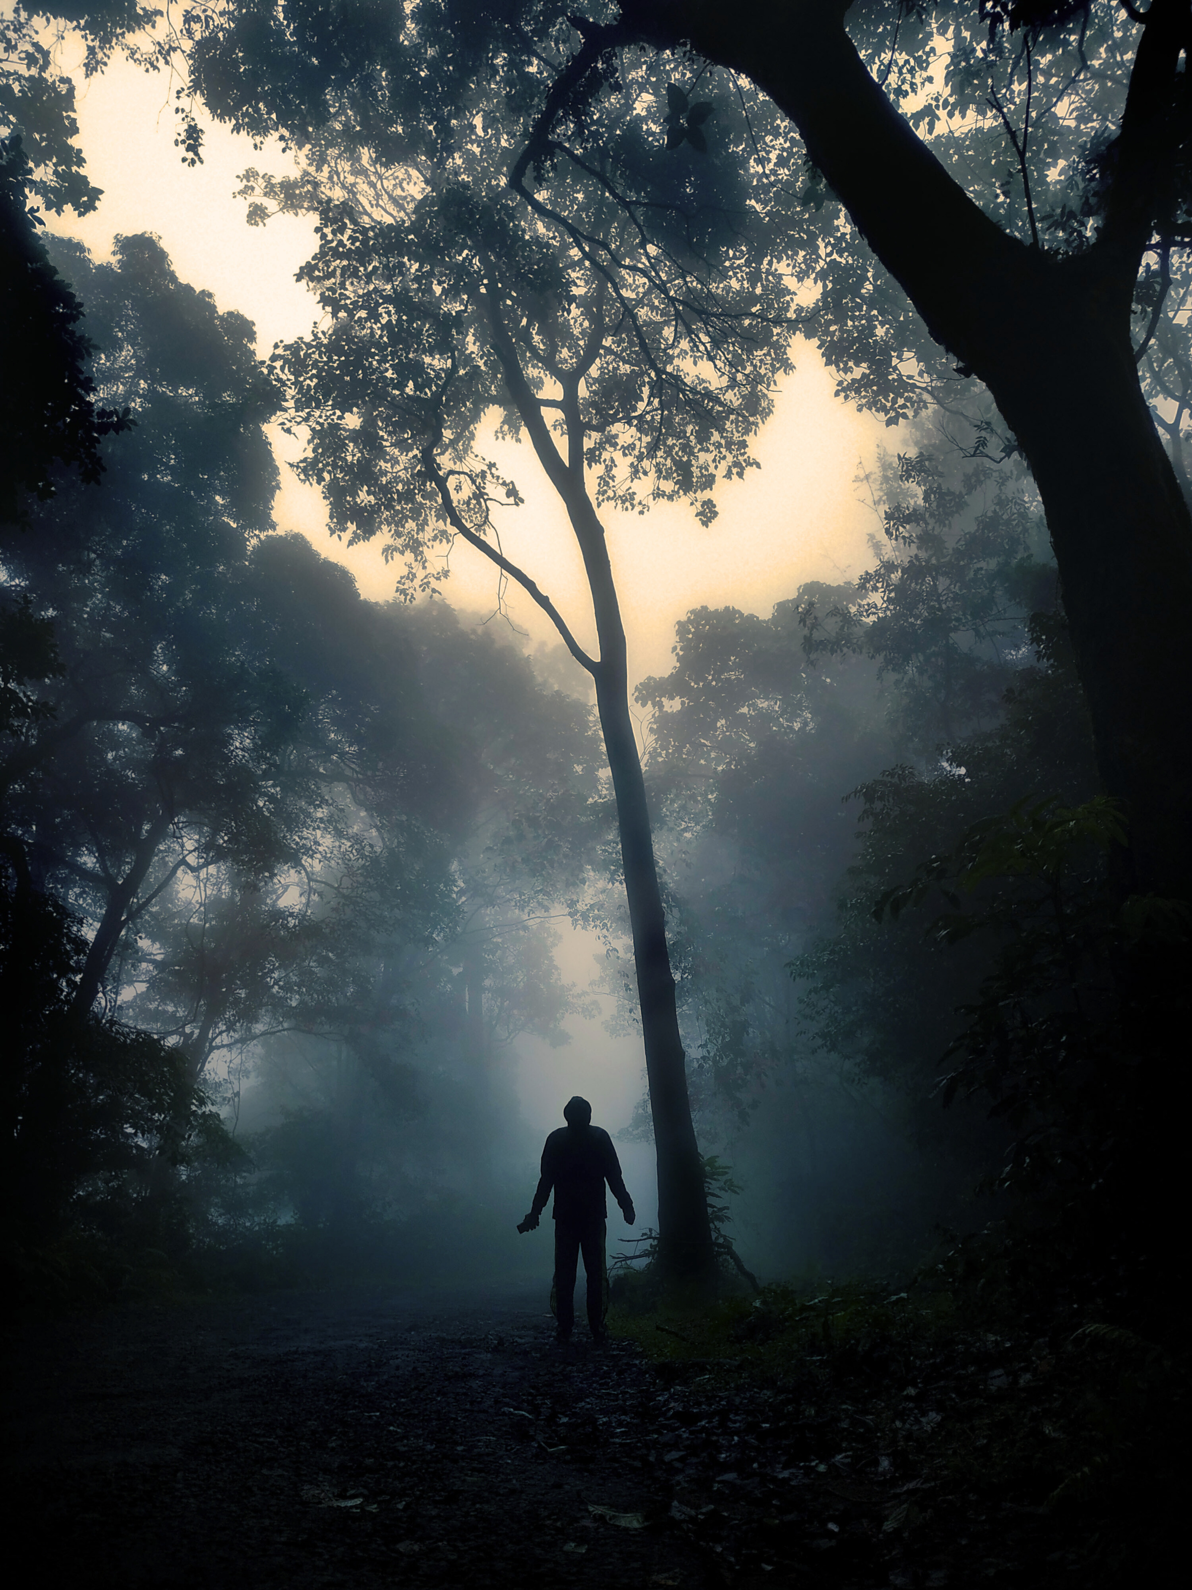

Top Productions
THE
RECKONING
PRESS KIT

Slide 2
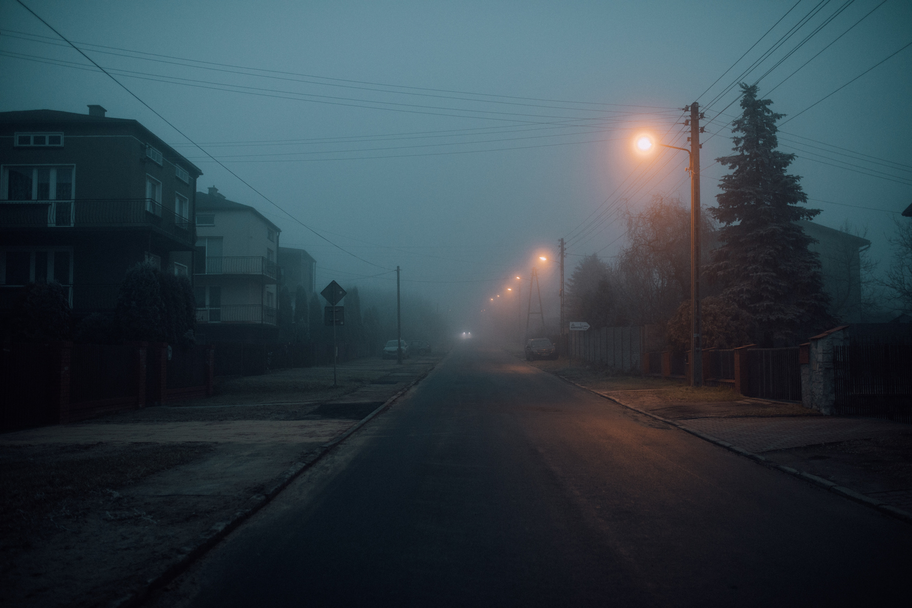
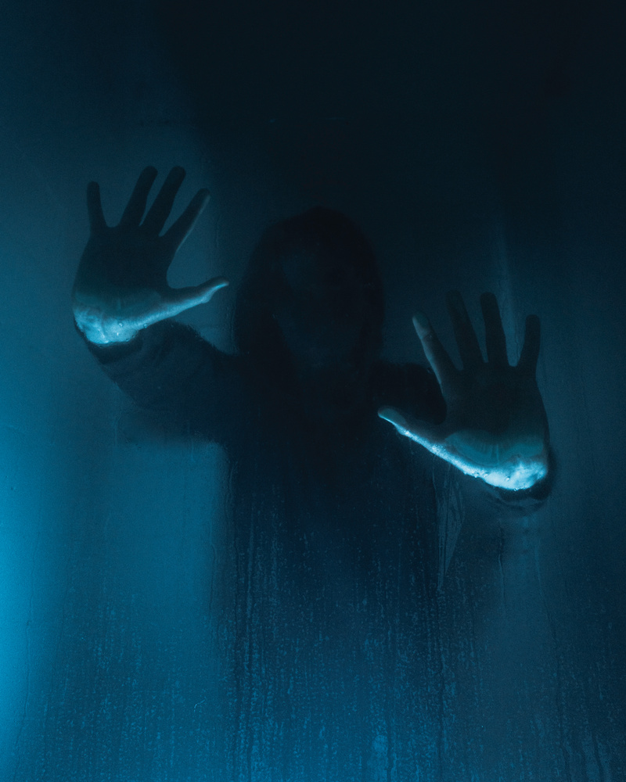
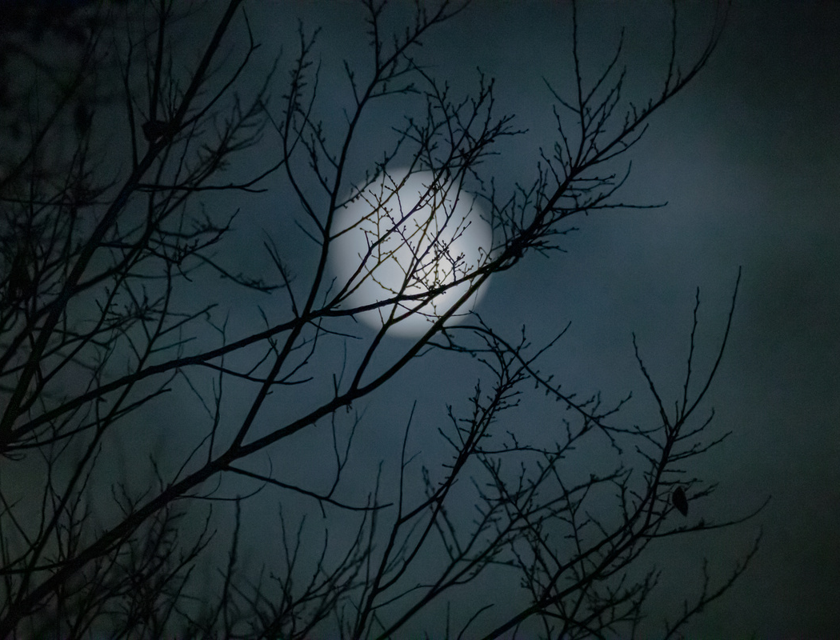
REVENGE WAITS FOR NO ONE

Slide 3

LOGLINE
When unidentified supernatural forces threaten to annihilate Earth, a band of outcasts must unite to survive and uncover a way to save humanity.
Tip: Drag and drop your photo or video. Select the sample photo or video and delete. Choose yours from Uploads, drag, and then drop inside the frame.

Slide 4

SYNOPSIS
Brief summary. Write a short outline of your dystopian thriller by introducing the gritty characters and the cryptic conflicts they must navigate, without revealing the ending.

Slide 5
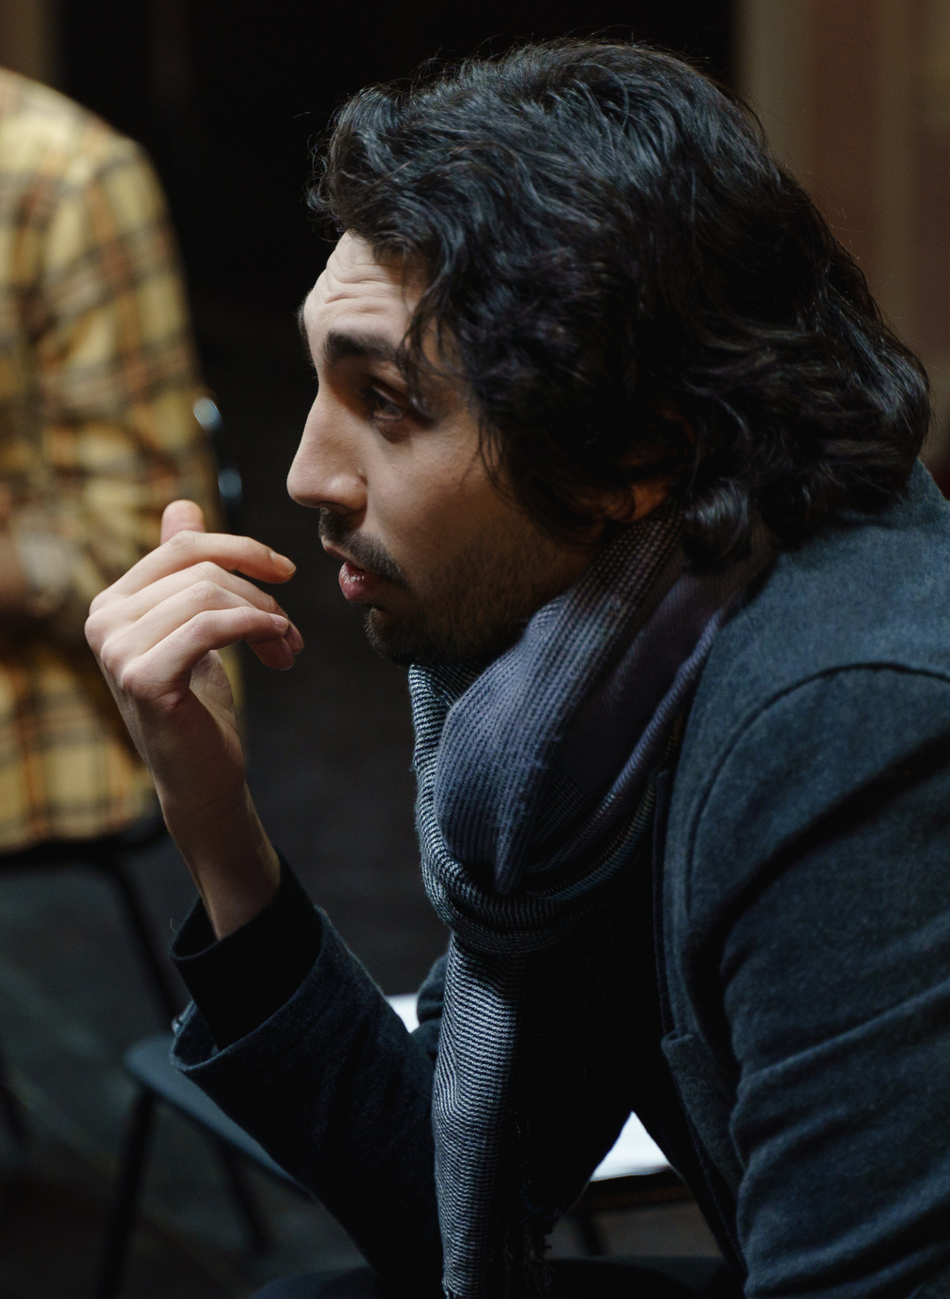
DIRECTED BY
SAMI MARKAJ
Director’s bio. Share their filmmaking experience, awards, and their vision for the film.

Slide 6
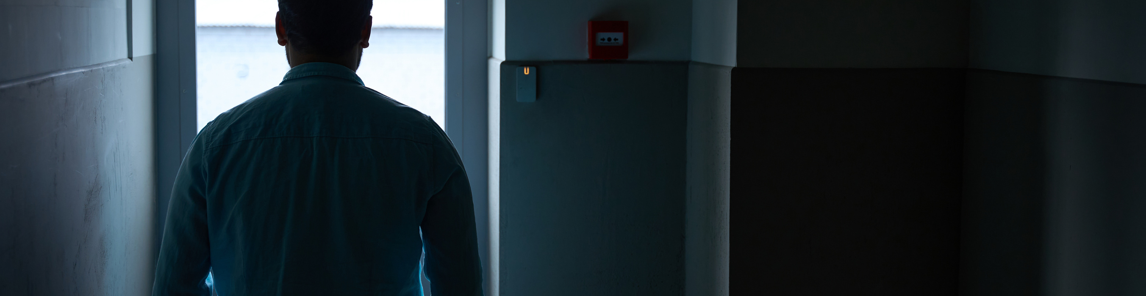
Theme of the film
SURVIVAL IN DYSTOPIA
The intriguing core message. Write a glimpse of the universal human experiences or societal issues this narrative is trying to convey to the audience.

Slide 7
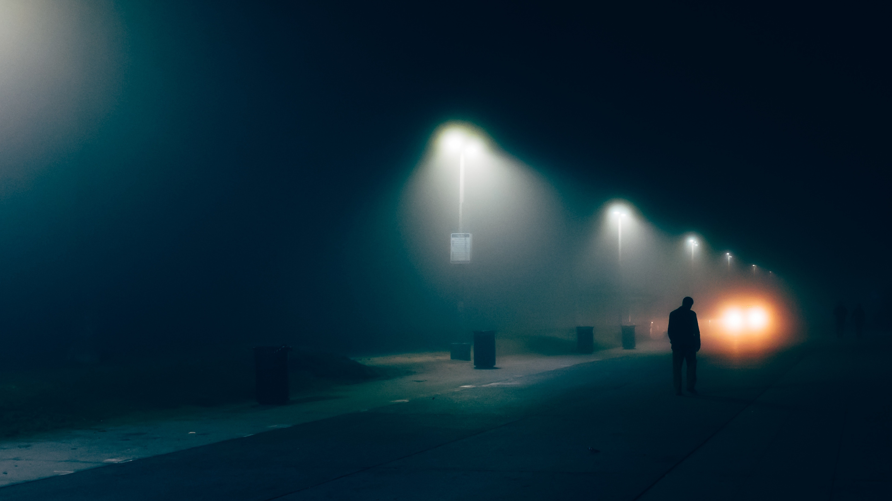
WE’VE GOT NOTHING LEFT TO LOSE. NOW WE STRIKE BACK.
Tip: Drag and drop your photo or video. Select the sample photo or video and delete. Choose yours from Uploads, drag, and then drop inside the frame.
— Gwyn

Slide 8
THE CAST AND CREW

Slide 9
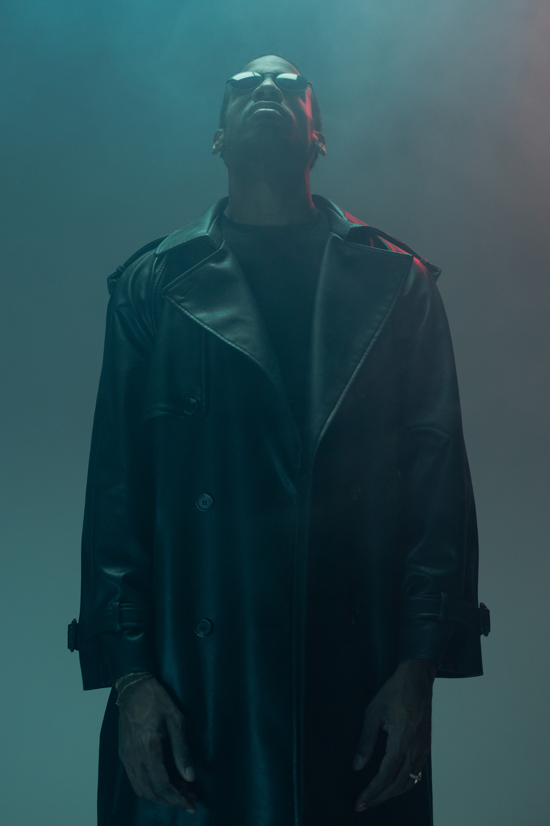
GWYN OLSSON
Played by Lane Defaux
Character background and the actor playing them. Include the character’s key traits and defining relationships, and the actor’s relevant recognitions and roles.

Slide 10
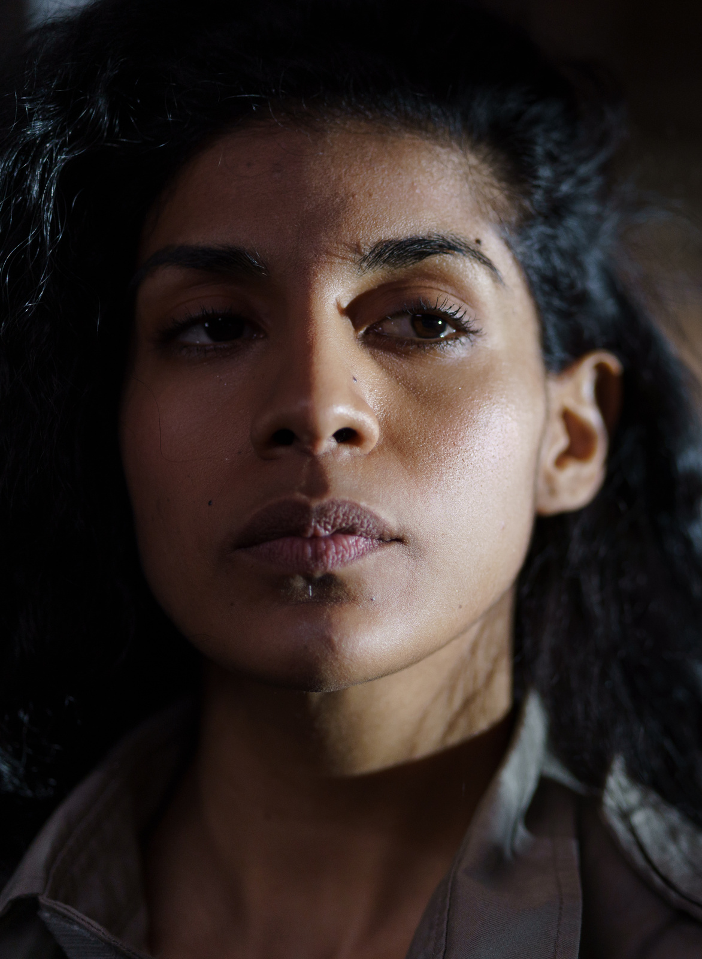
CAIUS SANCHEZ
Played by Kit Bauwens
Character background and the actor playing them. Include the character’s key traits and defining relationships, and the actor’s relevant recognitions and roles.

Slide 11
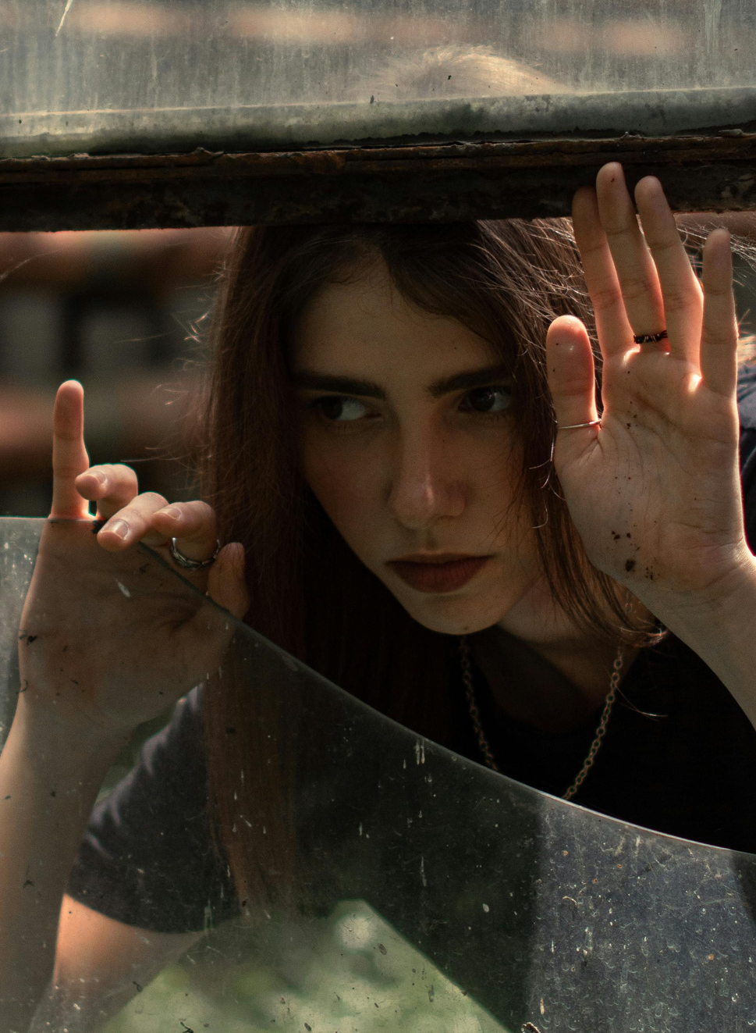
SIBYLLA WAGNER
Played by Edith Fernsby
Character background and the actor playing them. Include the character’s key traits and defining relationships, and the actor’s relevant recognitions and roles.

Slide 12


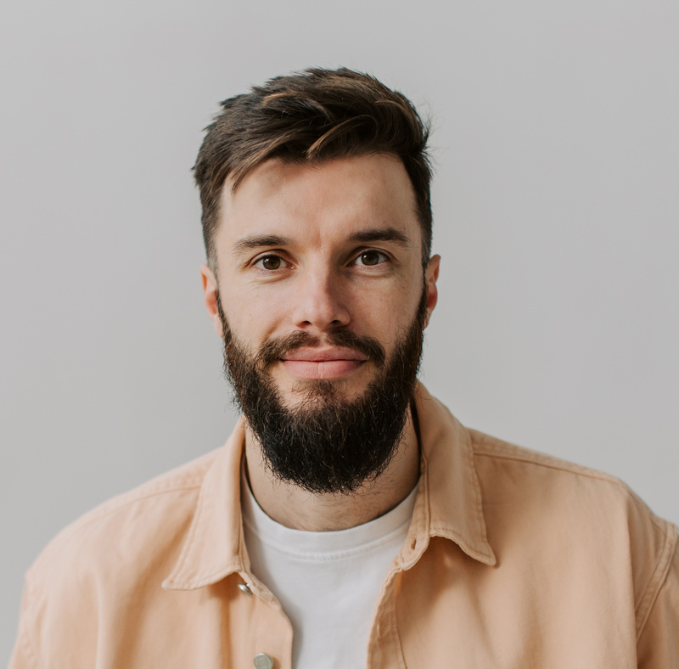
Tip: Drag and drop your photo or video. Select the sample photo or video and delete. Choose yours from Uploads, drag, and then drop inside the frame.
CREW CREDITS
HELLÄ KANERVA, PRODUCER
AYVAN PATEL, ASSISTANT DIRECTOR
NYLE ALCOTT,
LEAD WRITER
Share notable awards and details about the crew member
Share notable awards and details about the crew member
Share notable awards and details about the crew member

Slide 13
SCREENINGS
Tip: Customize this table. Right-click on any cell to see all the available table functions.
To merge, highlight two or more cells, then select Merge Cells to organize your table according to your needs.
Neo-noir International Fest | Silver Screen Cinema | March 12-15
Dystopian World Festival | Reel Feels Theater | March 14
Futuristic Film Fest 2030 | Dynamic Cinema | March 20
Thriller and Mystery Film Fest | Cinema Powerhouse | April 1-3
2030 Visionary Film Festival | Cultural Center | April 5

Slide 14
KEY FACTS
Production company
Production location
Genre, subcategories
Running time
Top Productions
North Rallegia
Dystopian, thriller
2 hours, 15 minutes
Audio format
Length
Shooting format
Aspect ratio
Digital Sound 1.5
Text
4k, high resolution
16:9
Exhibition format
Languages
Subtitles
Production year
4k digital
English
English
2030

Slide 15
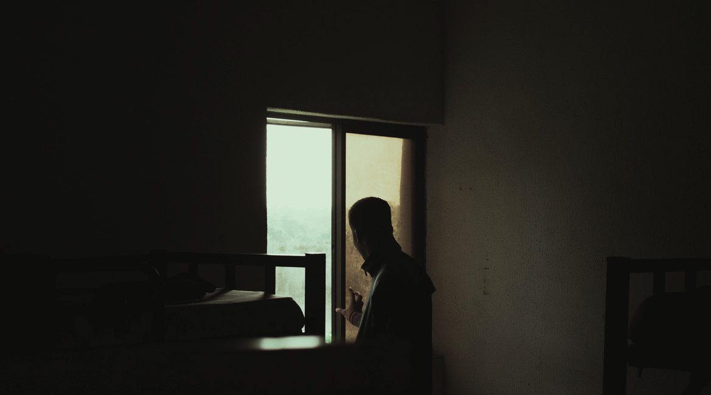
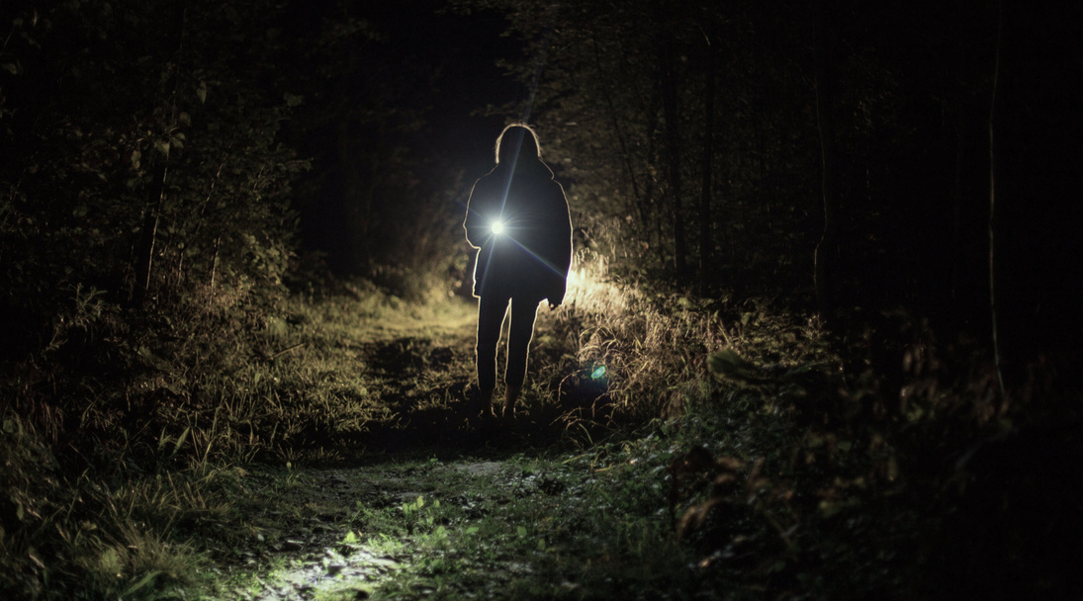
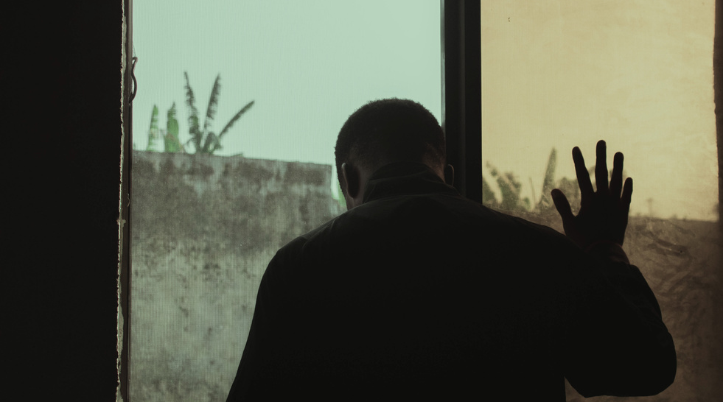
PRESS
“Gripping,
heart-pounding”
“Mysterious and thrilling”
“Prepare for the intensity”
Details about the
press coverage go here
Details about the
press coverage go here
Details about the
press coverage go here
Pop Bridge Media
Coco Page Media
Film Critics Group

Slide 16
GET IN TOUCH
Email
hello@reallygreatsite.com
Social media
@reallygreatsite
Phone
123-456-7890

